Slide 1
One Time Close Presentation

Slide 2
Agenda
Overview
Unlike traditional construction loans – which require a second credit qualification and closing before the loan converts to a permanent mortgage
AFR’s Conventional One-Time Close converts to a permanent mortgage in a single closing. This means no second closing, saving borrowers time and money
Available for both stick-built and manufactured homes, this program also contains fewer limits on property types and permanent mortgage options

Slide 3
Program Highlights
• Max LTV 95% for Modular, Multi-width Manufactured Homes
• Minimum credit score of 660-680
• Site Built homes are for FHA, VA and USDA today

Slide 4
Eligibility Overview
Here is an overview of the eligibility requirements for this loan program. View the Guidelines for the complete eligibility requirements.
• No need to requalify when all documentation used to qualify is less than 365 days (at time of converting to permanent mortgage)
• May be used with 15, 20, or 30-year fixed mortgages, super conforming mortgages, and high balance mortgages (in designated high-cost areas)
• Guidelines for this program are on the FSB Retail website

Slide 5
Loan Program FeaturesPremier Builders & Retailers
• Every One-Time Close Construction loan requires the selection of a Builder / Retailer to complete the project. AFR has established unique arrangements with an exclusive set of "Premier" Builders / Retailers, which allows us to offer additional flexibilities within our construction loan program guidelines.
• Builder Forms are on the FSB Retail Website, and this is step one for them to be approved

Slide 6
One-Time Close (OTC) Construction
Cost Breakdown
•All cost including the Soil Test, Inspection Test, Site Permits, etc are included in the Construction loan
•The Realtor commission is also paid as long as it is part of the builders contract.
•The Builder normally gets 10% Down upfront and this is in the construction cost at closing

Slide 7
Procedures to Follow
Mentor Gary Franklin
Steps for the Referring Loan Officer - APT LO Mentor and Support Staff
*Note the most important item to know on any 1 X Close Construction program is that the builder MUST act as the general contractor for the construction AND be approved PRIOR to Application. Please click on the below link to start the Builder Approval Process:
Link: c39de5_060f260579774ea384dd9a09fe1cce95.pdf (filesusr.com)
*Note that both “Stick Built” and “Site Built” options are only allowed for government loans. Conventional lending is limited to either manufactured or modular financing (Site Built).
REFERRING LO / APT MENTOR:
Make sure to review the contract and your construction contract estimate that it includes all areas of construction (if applicable unit, electric, plumbing, sewer, well, sodding/seeding, etc.).
This program requires a 5% Contingency and other builders “soft cost” fees that are calculated using a 1 X Close Construction Spreadsheet. This spreadsheet will help figure into the purchase price, the total amount to:
Pay the builder all the proceeds they require,
Acquire land (if not previously owned by the borrower)
Contingency figure
Other Builder “Soft Costs” including permits, lien searches, and construction interest.
VA/USDA loans require P&I payments to be included in the financing for the construction period.

Slide 8
Please contact Gary Franklin (the mentor on these products) if you require help filling out the spreadsheet.
Once you have completed the 1 X Close calculation spreadsheet, please print your calculations and upload those to Image flow within each loan. In addition, please upload the original builders contract for the total amount of construction if you have not done so previously in the builder approval stage.
Setting up your MBOT URLA:
Please enter the loan in MBOT as a normal Purchase.
You will find the total purchase price to enter in the borrower’s summary screen in this section on the 1 X Close Spreadsheet. Depending upon if the borrower owns the land or is purchasing the land, one of these two fields will give you the Brokerect purchase price:

Slide 9
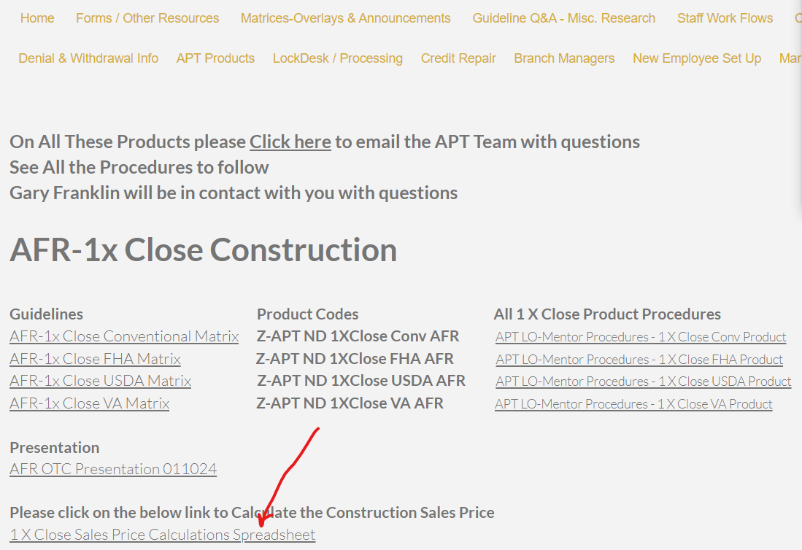
Product Information

Slide 10
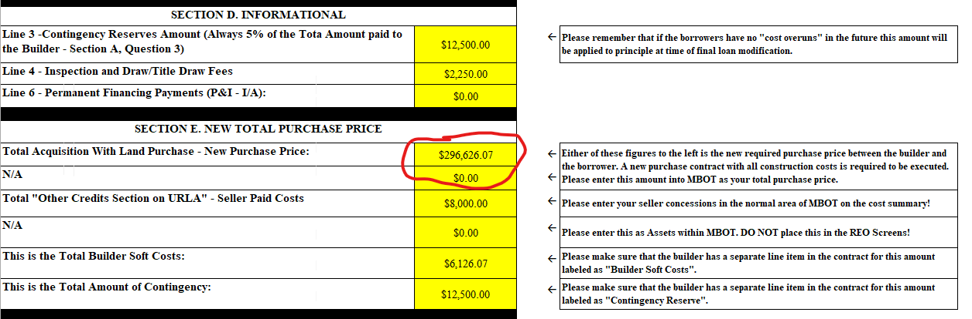

Slide 11
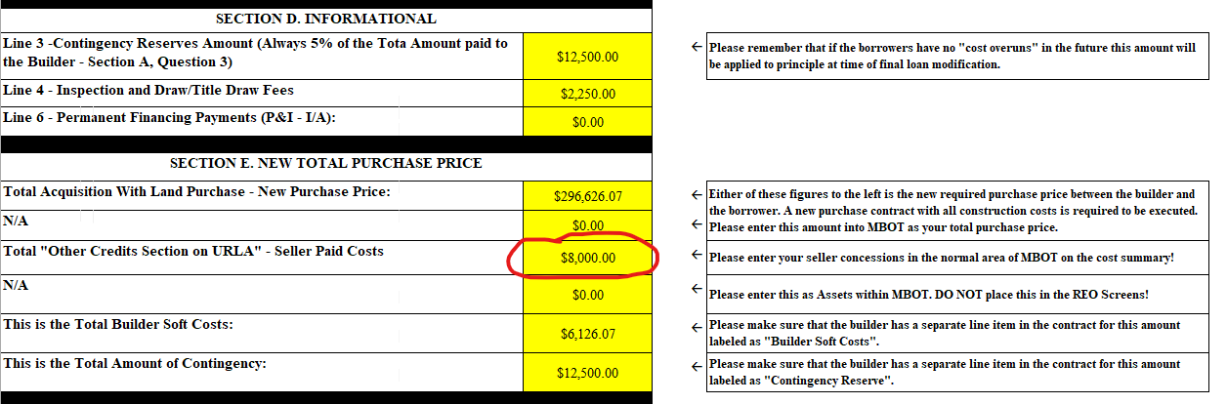
The only other Item to fill in on your URLA (If Applicable), is the seller/builder concession amounts in the Cost Summary Screen in MBOT. You will get that number here from the 1 X Close Calculation Spreadsheet.

Slide 12
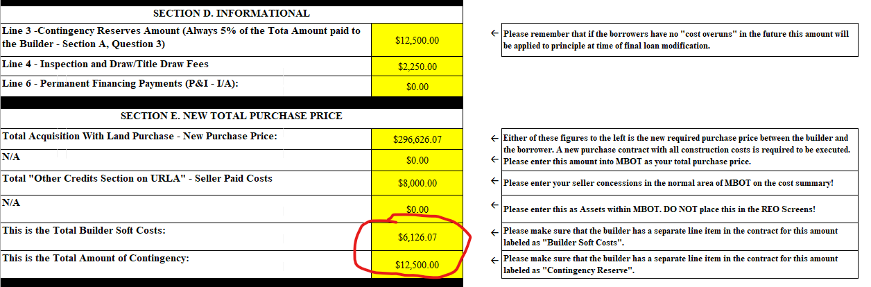
Note – Now that the Contingency, land acquisition and “Builder Soft Costs” have been included in a new TOTAL purchase price an amendment to the original contract between the builder and borrower must be executed. These fields from the 1 X Close Calculation Spreadsheet will help the builder add these line items to their total contract price:

Slide 13
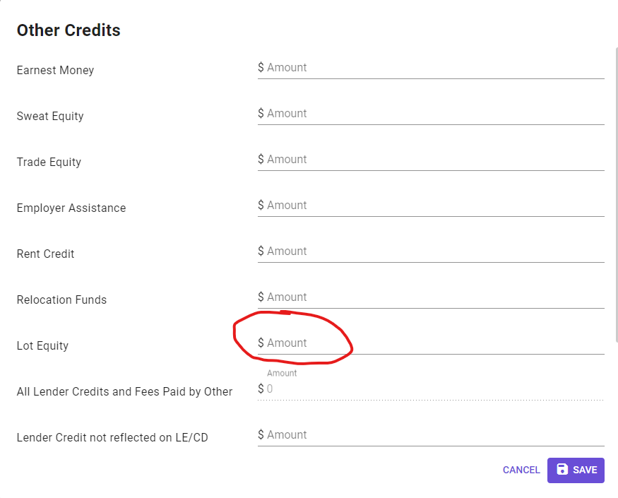

Slide 14
Please make sure to have the two-digit prefix of the loan number sequence changed to a “38” on all loan requests within the MBOT loan that was created. If you do not have access to change loan numbers, please send your request to loa@flanaganstatebank.com and that team will change your loan number prior to disclosing. Please remember to send any denials to apt@flanaganstatebank.com on this product.
We will not be disclosing out of MBOT. However, please make sure to do the following on the LE Screen in MBOT:
Should be set-up like a normal loan in the LO’s area so we know you normal appraisal, and title charges, recording, etc.
Please note that if this is an “Out of Area Loan” for the loan officer, make sure to check on transfer taxes.
Note that the following fees will be added to the investor’s LE.
Final Inspection/Draw fees of $2250
*Structural Engineers Report for Manufactured Housing Units.
All of these loans will be done at 2.75% lender paid comp (all site built) and 2.75% Borrower paid comp (Stick built).
There may be significant discount points required on this product. Please see the APT Rate Sheet for the exact amount. If there is not a maximum seller concession the program may not be viable. APT will make sure to charge for the appropriate discount on each loan before disclosing.

Slide 15
Please upload any financial information into each loan under “Submission Package”, and register each loan in MBOT.
Review to make sure that the services have been ran on all loan products (Credit, DV, Flood, DU or LP).
Review loan for approvability vs. any AFR Overlays from their site. If there are cost overruns on a post-closing basis the below form would be required:
Post Closing Link: c39de5_f442df78ce6f461e9bdb49e69b34be07.pdf (filesusr.com)
Please note that because you are the originating loan officer you MAY receive emails from AFR directly throughout the process requesting items, please forward these directly to your APT Processor and Mentor. COMPLETELY ignore these emails and DO NOT respond.
Must have Builder Permits no exceptions, PRIOR to closing.
Weekly Communication
APT will invite you to a weekly pipeline call at 9:30 AM CST every Thursday if you have a loan disclosed and in process, if you have selected that option. You may choose NOT to attend, but this is highly recommended.

Slide 16
APPROPRIATE CLOSING TIME FRAME ON CONTRACTS:
FSB will NOT accept less than a 90-day contract if there is a land seller involved in the loan closing not affiliated with the builder.
FSB will NOT accept less than a 90-day contract on any Stick Built submissions.
FSB will accept 60-day contracts at a minimum if there is NO land seller, it is not for stick-built construction, AND builder is cooperative during the initial builder approval phase.

Slide 17
UNDERSTANDING THE RATE LOCK POLICY:
All 1 X Close Products will be disclosed at the construction note rate. This is the highest rate on the APT rate sheet for each product.
At time of final underwriting submission, the interest rate is locked on the end loan at the current market. This rate lock will be the final note rate at the time of construction completion. *Note- The only exception to this rate policy is on FHA “Stick Built” construction OR, If the builder goes past the allotted time frame (generally 12 months), the rate may be subject to change. If the loan is for an FHA Stick Built property the highest rate available is ALSO the final permanent interest rate.
There is NOT a float down option for this loan product after construction completion, however, AFR encourages refinancing currently if the market conditions exist to all agency guidelines. In these situations, please contact the assigned Mentor at the time of application on each refinance.
Please add a note to MBOT if you want to retain the borrowers and builder contact throughout the loan process, or if you want APT processing to handle all the communication.
Once you have a completed application AND after builder approval, please send an email to apt@flanaganstatebank.com and ask for the loan process to be started on each loan. Simply state, “Please disclose this 1 X Close Construction Loan”.

Slide 18
APT MENTOR:
Will help on the builder approval process and verify the builder is approved and the borrowers are qualifiable.
Please make sure the Purchase Agreement is uploaded to the file.
Please make sure to upload the AFR “Construction loan Cost Figures” worksheet provided by AFR to each loan.
Please make sure to make this new loan “Non-HMDA Reportable”.
APT Mentor confirms the registration is done on AFR’s site AND DU is Approve Eligible.
APT Mentor will make sure a note about processing contact has been entered into MBOT.
Once complete, please send an email to aptproc@flanaganstatebank.com to have processing take over the loan disclosure and loan processes.

Slide 19
APT PROCESSING:
Processing team will locate each loan in the AFR pipeline after registration.
Processor will make sure that DU AUS findings are ran directly within AFR’s site!
APT Team will request disclosures in AFR’s site.
The loan will be processed in the manner selected by each loan officer.
APT Processor will move each loan to “UW Approved W Conditions” after the investor has approved each loan.
APT Processor at time of final resubmission to AFR will request the “Float Down” to permanent interest rate lock by emailing lockdesk@flanaganstatebank.com .
Once each loan is cleared to close, APT Processor will upload all final Cleared to Close Statuses on this loan product to MBOT and move the loan to a “U/W DECISION - FINAL APPROVAL/READY FOR DOCS” but will NOT final the loan for closing.
Once loan funding has taken place, the APT division will mark each loan funded.

Slide 20
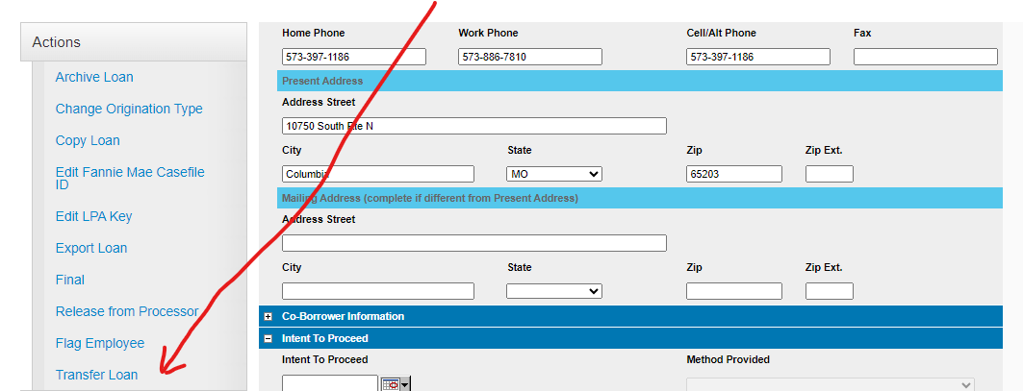
After loan funding the APT Division will transfer the loan into (NOT copy a new) APT Institution for commission purposes. See screen shot below:
Our APT Loan Processors will disclose within our investor sites and process all loans throughout the entirety of each loan submission. During the process you will have access to any brokered loan submission. However, after loan funding the loan will be transferred to our APT pipeline, and you would no longer have access to each loan for future solicitation. If you ever need a loan copied in the future to provide customer service on a new application for borrower(s), please email apt@flanaganstatebank.com and our team will copy the loan file for you when requested. Please clearly state, “please copy this previously funded brokered loan into my name.”

Slide 21
You Tube help for your customer
https://www.youtube.com/watch?v=YgAisLjdMYc&t=3s
You Tube Help for Builders
https://www.youtube.com/watch?v=09QjKVaYQdo

